Slide 1


KFIB Investors entry point into KUWAIT
وزارة التجارة والصناعة
Ministry of Commerce & Industry
KFIB one of the Implementing bodies of Kuwait Development Strategy

Slide 2
About KFIB
About KFIB
KFIB was launched in 2003 as a division under the Ministry of Commerce & Industry in accordance with Law no. 8/2001 and the relevant executive orders with the mandate to attract Foreign Direct Investment (FDI) into the State of Kuwait, and to serve as first entry point for foreign investors to facilitate establishing their investment projects.
KFIB operates under the umbrella of the Emir’s vision and the Development Plan (2010/2011-2013/2014) economic and social objectives, which also provides for mega investment opportunities more than US$ 100 billion open for local private sector and interested foreign investors.

Slide 3
The Emir’s vision
The Emir’s Vision is the enunciation of Kuwait into an international financial & commercial Hub.
The Vision is achieved through
Positioning Kuwait competitively as a leading financial & Commercial
hub in the region.
Developing necessary legal framework
Ensuring transparency & good governance.
Capitalizing on the advanced skill sets of Kuwaiti nationals.
Strengthening the role of the private sector.
Building national consensus.
Benefiting from the strength of democratic practices in Kuwait.

Slide 4
Why FDI into Kuwait?
Kuwait FDI Objectives
Transfer and settlement of modern technology.
Creation of high calibre jobs for nationals.
Provision of quality training opportunities.
Support of local private sector .
Supporting domestic industries and their export potential.

Slide 5
KFIB Vision
KFIB Vision
Foresee Kuwait as a world class competitive financial & commercial hub and attractive location for high value added FDI that maintains sustainable economic and social goals fostering knowledge based economy and green technology.

Slide 6
KFIB MISSION
KFIB Mission
Actively promote Kuwait as investment hub through formulation of successful partnerships in line with the development goals, streamlining the business environment in cooperation with various stakeholders and supporting the establishment of viable competitive export-based industrial clusters.

Slide 7
KFIB Tasks
KFIB Tasks
Promotes Kuwait as a location for investment.
Handles the full process of investment application for the investment project.
Provides investor services and aftercare throughout the investment cycle.
Identifies and promotes viable investment opportunities.
Provides needed information and market intelligence.
Contributes to streamline overall doing business environment.

Slide 8
KFIB Organizational Structure
KFIB is Composed of 3 departments: Promotion, Information and Communication Department, Studies And Project Evaluation Department, Investors Services Department. There are 11 sections.
The Foreign Capital Investment Committee (FCIC), headed by the Minister of Commerce & Industry, is highest authority to grant the final approvals for FDI projects.
There are 3 sub-committees: study licensing applications & granting incentives, promotion and media, Review & Upgrading.

Slide 9
KFIB Institutional Setup
Ministry of Commerce & Industry (Minister)
The Foreign Capital Investment Committee (FCIC),
Kuwait Foreign Investment Bureau (KFIB)
Review & Upgrading Sub-committee
Promotion & Media Sub-committee
Study Licensing Applications & Granting Incentives Sub-committee

Slide 10
Studies And Project Evaluation Department
Conduct needed studies and research.
Assess investment opportunities.
Investigate & analyze problems to suggest options.
follow-up with concerned entities procedures for approving the investment licensing application.
study investors inquiries concerning legal issues.

Slide 11
Investors Services
Investors Services Department
Handles inquires from investors.
facilitates all the procedures of issuing investors licenses in coordination with other concerned entities.
Implement incentives granted to approved investment projects.
Follow up and monitor established projects.
Help solving investors complaints.

Slide 12
Promotion, Information & Communication Department
Conduct various promotional and marketing campaigns.
Manage and run KFIB website.
Prepare market intelligence and databases.
Handle all related matters for convening the Foreign Capital Investment Committee (FCIC), and its 3 sub-committees, and follow up its resolutions.
Manages the administrative, HR, and financial support services.

Slide 13
KFIB Airport Branch
Opened officially 20 February 2011.
Serves the purpose of:
  raising awareness on KFIB role and mandate.
  Handing marketing kits, brochures on KFIB services, and copies of FDI law 8/2001 (E/A/F).
  Responding to inquires from potential investors and visitors to Kuwait.
  Detecting initial interest amongst investors and continue following up with them.

Slide 14
1. Institutional Support
KFIB Services
Receives and responds to investors inquires and applications;
Promotes open sector/ economic activities for FDI.
Facilitates needed procedures;
Coordinates with a network of stakeholders including concerned government entities;
Issues investment licenses for FDI projects;
Grants incentives and guarantees to foreign investors;
Follows up with FDI projects implementation to ensure addressing obstacles and achievement of intended FDI goals;
Distribute marketing kits and information on KFIB, FDI Law, and the country attributes.
Organizes and participates in various local and international marketing campaigns, road shows, and exhibitions to promote Kuwait as a location for FDI.

Slide 15
3. Incentives
Incentives
KFIB grants incentives as follows:
Tax exemptions for a maximum period of 10 years.
Total or partial exemption from customs duties on project’s imports of manufactured goods, packaging materials, etc.
Total or partial exemption from other export and import restrictions.
Allocation of land and real estate in accordance with Kuwaiti laws.
Allowing the recruitment of foreign labor in accordance with of Kuwaiti laws.
Benefits arising under Double Taxation Treaties (DTTS) and Bilateral Treaties for the Encouragement and Protection of Investment (BITs).

Slide 16
4. Guarantees
Guarantees
KFIB ensures that guarantees are provided to foreign investors including:
Protection against expropriation, compulsory disinvestment or nationalization, and providing fair and timely compensation if confiscation occurs due to security or public interest.
Allowing free repatriation of foreign investors profits and capital without any restrictions, and if compensation paid on account of disinvestment.
Protection of project information propriety.

Slide 17
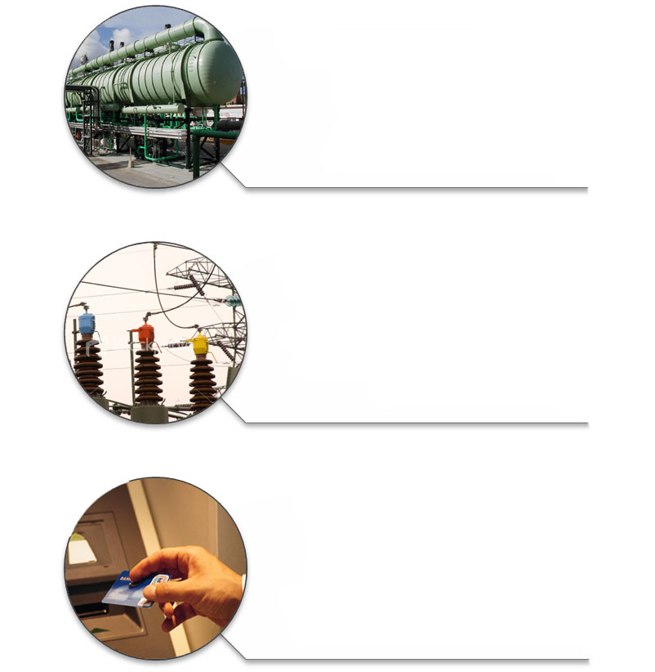
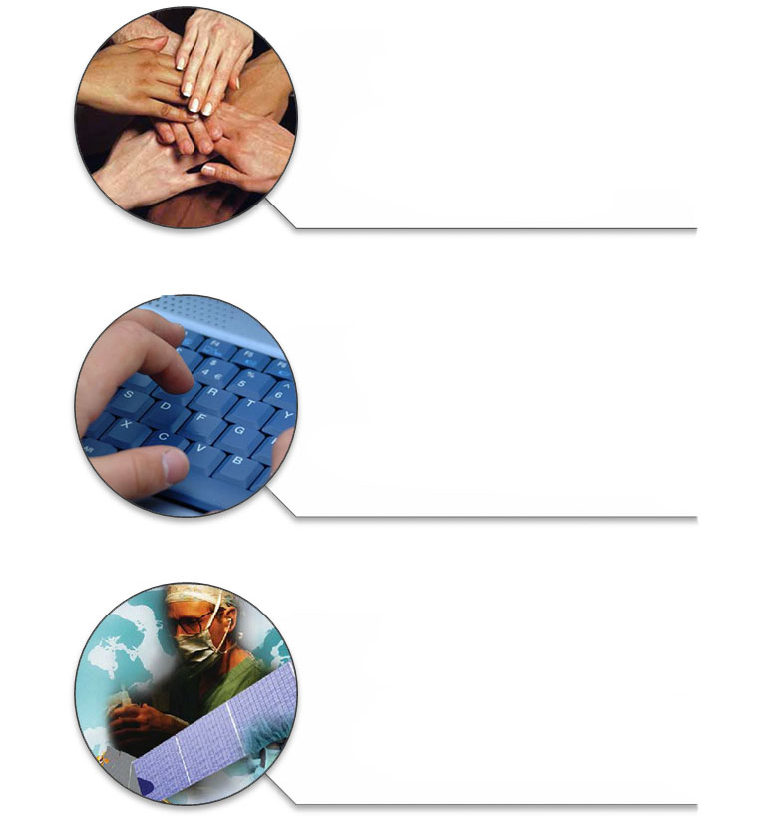
13 Open Economic Sectors for FDI
KFIB attracts investors into the open economic sectors for FDI:
Insurance Companies
As approved by the
Ministry of Commerce &
Industry.
Information
Technology &
Software development.
Hospital
& Medicines
Manufacturing.
Industries
Except oil & Gas
Exploration / Production.
Infrastructure
In the fields of water &
Electricity generations,
Wastewater system etc.
Banks
Investment corporations
& foreign exchange
Companies approved
by the Central Bank.

Slide 18
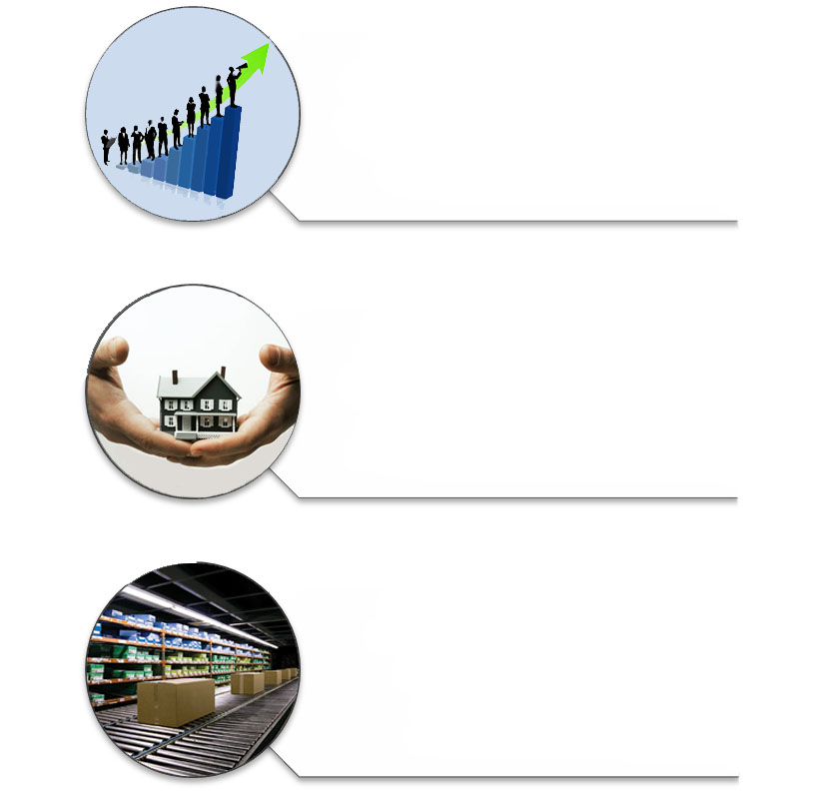
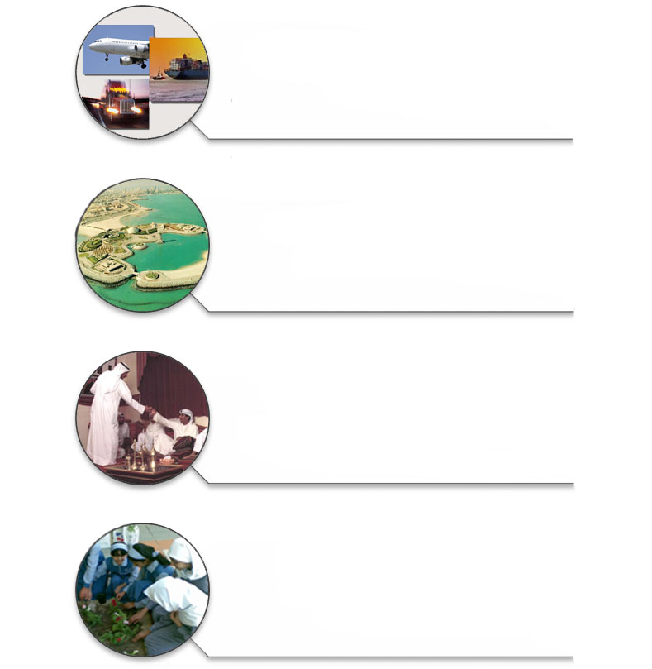
13 Economical Sectors
Continued
13 Open Economic Sectors for FDI.
Transport
Land, Sea & Air.
Tourism
Hotels &
Entertainment.
Culture & Media
(except newspapers
magazines &
publishing houses).
Environmental
Activities.
Integrated
Housing
Projects.
Real estate
(guided by Law
No. 20 / 2002).
Storage &
Logistic services.

Slide 19
KFIB network with Various stakeholders (Local, Regional, International)
KFIB
Kuwait Chamber of Commerce & Industry
Concerned government entities
Joint business councils, embassies,
Local civil organizations (unions, professional societies)
National Offset Company (NOC)
international organizations
(UN, World Bank)
Media and communications companies(OBG, BBW)_
World Association of Investment Promotion Agencies (WAIPA)
Kuwait Diplomat Institute
Arab regional organizations
(Dhaman, API)

Slide 20



KFIB Success Stories (2003-2010)
BNP Paribas Bank.
HSBC Bank.
Citi Bank.
Financial Cluster of Branches of Foreign Banks

Slide 21


KFIB Success Stories (2003-2010)
Success Stories
Petrochemical Industry
Kuwait Olefins Company (Ethylene & Ethylene Glycol).
Kuwait Styrene Company.
Kuwait Polyethylene Company.
Petrochemicals Cluster

Slide 22
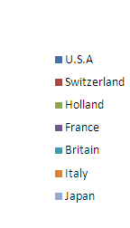
Kuwait FDI Partners (2003-2010)

Slide 23
KFIB Next Steps
Improved investor services (OSS);
E-links with various government entities;
Investment Opportunities & investment map;
Land Development (3 zones in Abdali, Shagaya, Wafra).

Slide 24
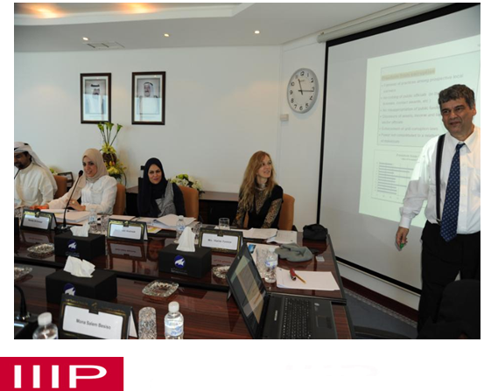
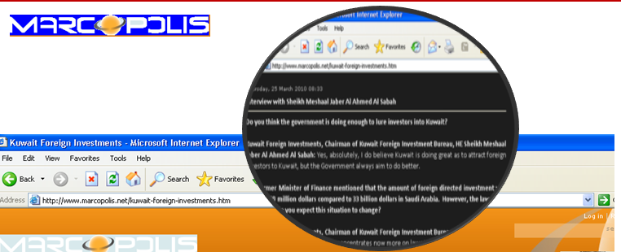
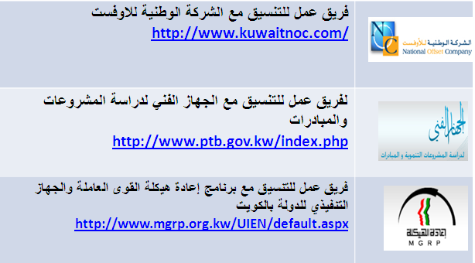
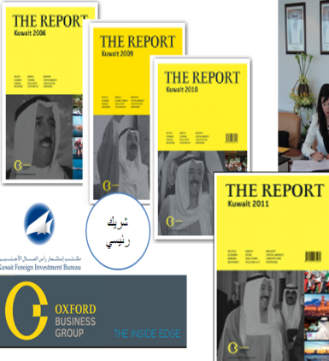

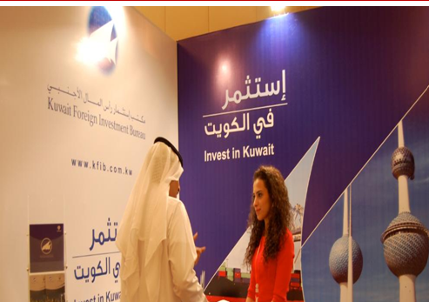
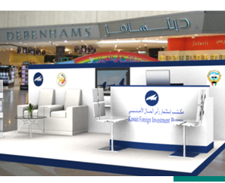
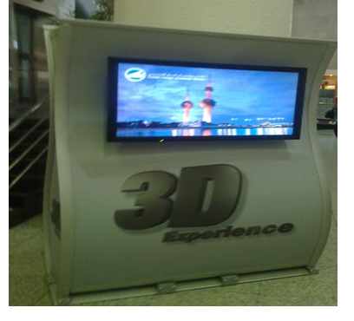
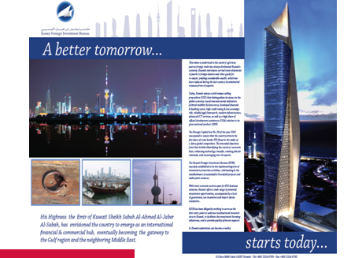
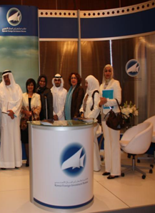
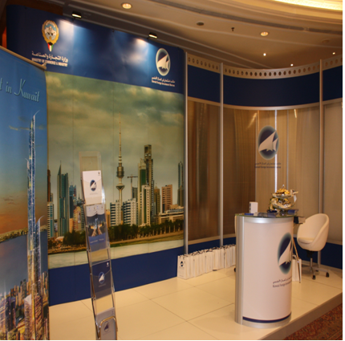
KFIB Activities

Slide 25
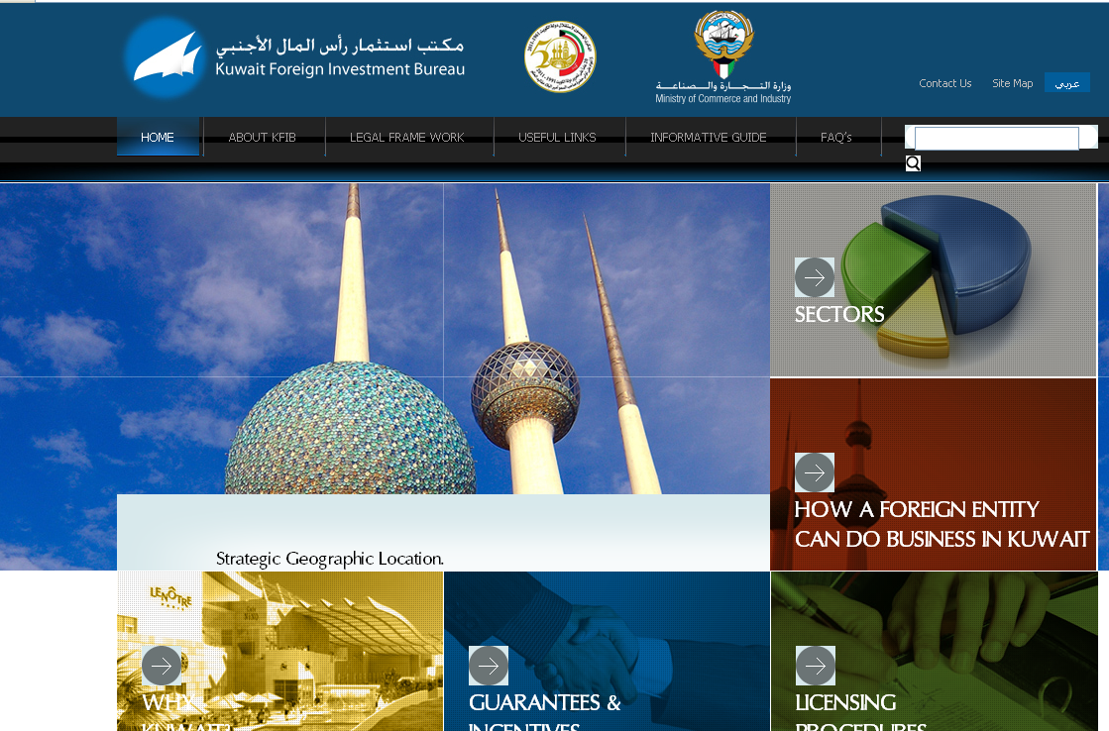
For more information KFIB website

Slide 26
Contact Information
Kuwait Foreign Investment Bureau
Burj Al Madinah (City Tower)
Khaled Ibn Al Waleed street, Sharq
Tel: +965-22-240-700
Fax: +965-22-240-713
P.O. Box: 3690 Safat 13037 Kuwait
E-mail: info@kfib.com.kw

