Slide 1
The Kuwait Offer

Slide 2
Kuwait …Vision Towards 2035
Transforming Kuwait into a financial and commercial hub which is attractive for investment, and developing an economy led by the private sector, fueled by the spirit of competition, while raising the productivity and efficiency with the support of state institutions. Maintaining values and social identity, while achieving human development, providing appropriate infrastructure, sophisticated legislation and encouraging business environment.

Slide 3
MAJOR MACRO ECONOMIC INDICATORS KUWAIT
(Fiscal year ending march 31 st )
(Fiscal year ending march 31 st )
(Fiscal year ending march 31 st )
Kuwait Strong Macroeconomic Performance
(USD billions) | 2004 | 2005 | 2006 | 2007(e) | 2008(f) | 2009(f)
Economic growth (%) | 10.6 | 11.5 | 6.3 | 4.8 | 4.5 | 2.4
Inflation (%) | 1.1 | 4.1 | 3.1 | 5.5 | 9.0 | 7.5
Public sector balance (%GDP) | 21.2 | 34.1 | 30.7 | 39.1 | 22 | 4.0
Current account balance (%GDP) | 30.6 | 42.2 | 50.8 | 42.3 | 39.6 | 15.5
Foreign debt (%GDP) | 20.4 | 20.4 | 26 | 43.6 | 31.5 | 34.7
Debt service (%Exports) | 3.1 | 1.4 | 2.0 | 3.3 | 2.5 | 3.5
Foreign exchange reserves (in months of imports) | 4.4 | 3.7 | 5.1 | 4.8 | 4.9 | 4.7
Coface,March 2009
(
DISCLAIMER : The present document reflects the opinion of COFACE Country Risk and Economic Studies Department, as of the date hereof and according to the information available at this date; it may be modified at any moment without notice. Information, analysis, and opinions contained herein have been elaborated from numerous sources believed to be reliable and serious; however, COFACE does not guarantee in any manner whatsoever that the data contained herein are true, accurate and complete. Information, analysis, and opinions are provided for information purpose only and as a complement to material or information which shall be collected otherwise by the user. COFACE does not have any procurement obligation but only obligation of means and shall incur no liability whatsoever for losses arising from the use of or reliance on the information, analysis and opinion herein provided. This document together with analysis and opinions furnished are the valuable intellectual property of COFACE; you may download some of the data for internal use only, provided that you mention COFACE as author and you do not modify or alter such data. You may not use, extract or reproduce the data in whole or in part, for making any public statement or for any other commercial purpose without our prior written consent. You are invited to refer to the legal notice provided on COFACE web site.

Slide 4
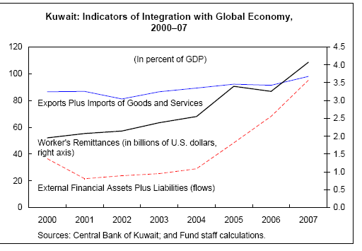
Kuwait Integration into Global Economy
IMF, June 2008

Slide 5
Kuwait External Relations 2007
Exports by commodities groups:
Fuels & Mining products 96.1%
Manufacturing 3.7%
Agriculture 0.2%
Kuwait Main Trading Partners (Exports to):
Japan 20.3%
USA 11.0%
EU(27) 7.8%
Taipei, Chinese 3.8%
Singapore 2.2%
WTO, ITS, 2008

Slide 6
Kuwait External Relations 2007
Imports by commodities groups:
Fuels & Mining products 2.3%
Manufacturing 85.7%
Agriculture 12.0%
Kuwait Main Trading Partners (Imports from):
EU(27) 33.2%
USA 10.6%
Japan 9.6%
Saudi Arabia 6.5%
China 4.4%
WTO, ITS, 2008

Slide 7
Kuwait Sovereign Rating
S&P Sovereign Rating
Foreign & Local currency AA-/Stable/A-1+
Moody's Sovereign Rating
Foreign& local currency government bond ratings, Aa2
with a stable outlook
Fitch….
Kuwait Country Credit Risk Rating
Coface@Rating: A2
The political and economic situation is good. A basically
stable and efficient business environment nonetheless
leaves room for improvement. Corporate default probability
is low on average.

Slide 8
Kuwait Ranks within the top 30% countries in International Indices 2009 ...except corruption
# | Index | Rank No. of Countries | Rank percentile
1 | INSEAD Global Innovation Index | 30/130 | 23%
2 | WEF Global Competitiveness Index | 35/134 | 26%
3 | HF/WSJ Index of Economic Freedom | 50/183 | 27%
4 | WB Ease of Doing Business Index | 52/181 | 28%
5

