Slide 1

Kuwait Foreign Investment Bureau
The Offer and the Promise

Slide 2
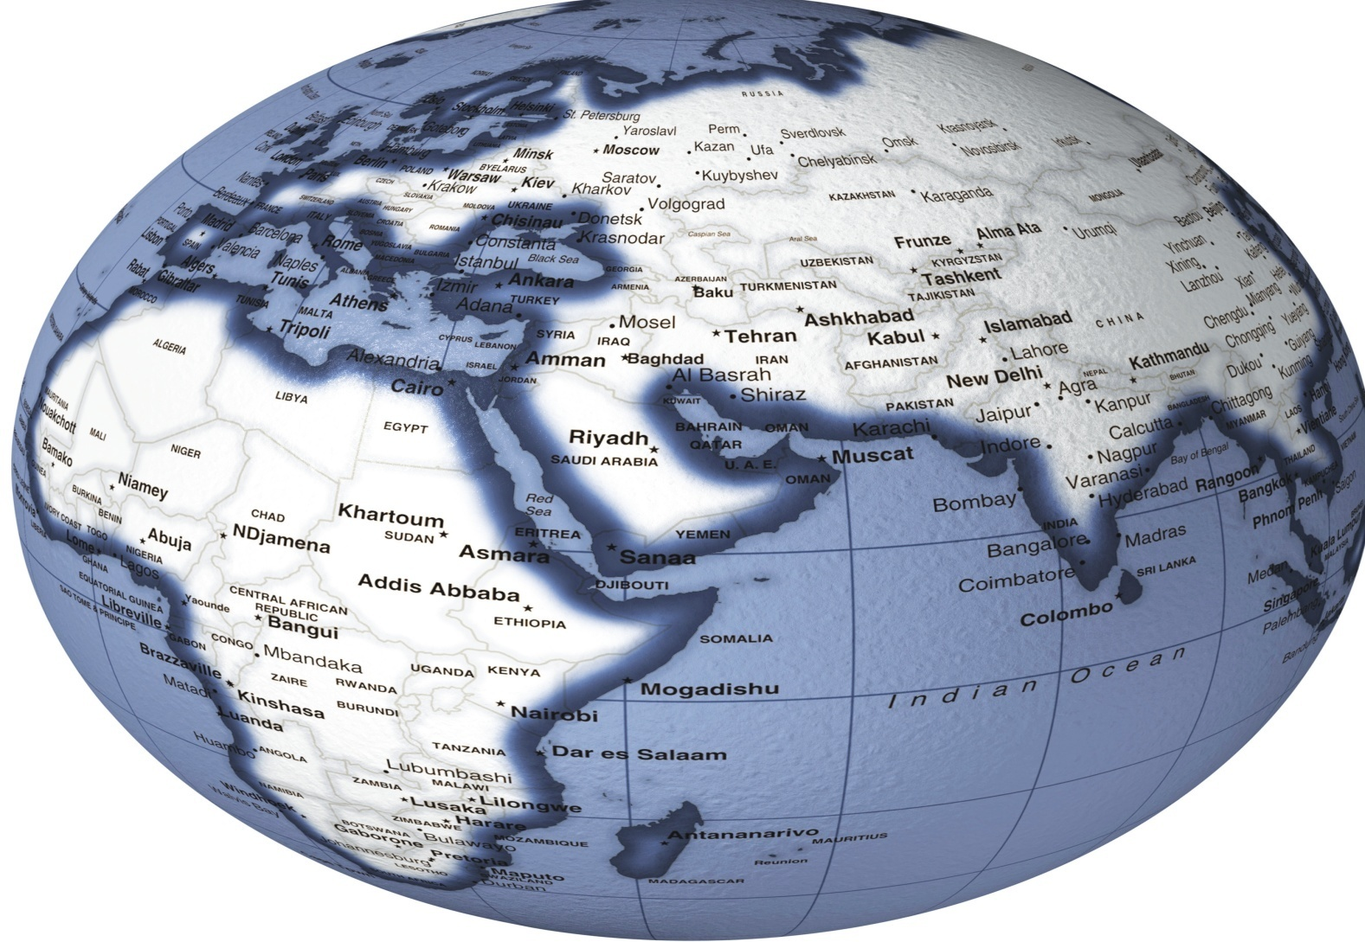

Our Location
300 Million market
KUWAIT

Slide 3
Kuwait Offer
$100 billion in investment projects(Development Plan)
Stable & secure (low Risk)
Low corporate tax rate (@15%)
Competitive cost of doing business (fuel & electricity prices)
Favorable ICT infrastructure (fast + competitive)
Promise
Commitment to make Kuwait a business friendly environment.

Slide 4



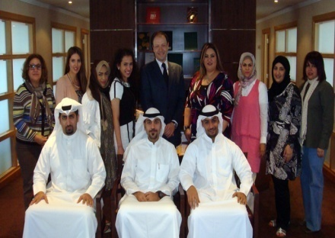
Kuwait National Goals
Raise Kuwaiti employment from 15.5% to 21.0% total labor force.
Raise share of private sector in GDP from 37.5% to 44%
Train >3000 Kuwaitis p.a.
Establish 150 SMEs
Raise share of RD &I from 0.2% to 1.0% of GDP.
Source: Kuwait Development Plan(2010/2011-2013/2014)

Slide 5
Why FDI in Kuwait?
The transfer of modern technology
Job creation & training for national labor
Support SMEs
Encourage
of national exports
Promotion of national projects’ expo

Slide 6
KFIB Offer
Investment decision
Ministry of Commerce & Industry
Foreign Capital
Investment Committee
KFIB
Investors Services Dept.
Studies & Project Evaluation Dept.
Promotion, Information, Communications & Dept.
  Customer Focused
Investors services
Market Intelligence
Branding Kuwait

Slide 7
KFIB Offer
Investment application
Incentives application

Slide 8
KFIB Promise
Promote Kuwait as Investment hub.
Identify investment opportunities.
Present needed information.
Issue investment licenses for Projects.
Provide investor services & follow up.

Slide 9


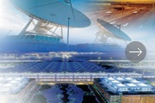

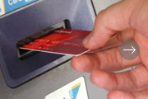
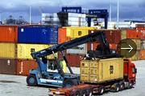


Welcoming FDI into
Information
Technology
Hospital
& pharmaceuticals
Storage &
Logistic services
Environmental
Activities
Industries
Except oil & Gas
Exploration/production.
Construction
Banks
Transport
Land, Sea & Air.

Slide 10
Guarantees
Protection against expropriation.
Free repatriation of profits & capital.
Protection of project information.

Slide 11

Incentives
Exemptions of income tax.
Up to 100% foreign ownership.
Benefits under DDTs and BITs.
Allocation of land
Total or partial exemptions from customs duties.

Slide 12
Legal Forms of Companies
Limited Liability Company (W.L.L) .
Branch of parent company
(International Banks)
Closed Joint Stock Company (K.S.C.C)
(up to 100% foreign ownership)

Slide 13
Recent Developments
Improved website
Airport Branch
Investor Services Center
Institutional Support
In Progress
E-Government
Economic Zones Development
New Modern FDI Law
Investment Map
Streamlining business environment procedures

Slide 14

Thank you
www.kfib.com.kw

